Slide 1

Houston, TX
2019
#XamDevSummit

Slide 2
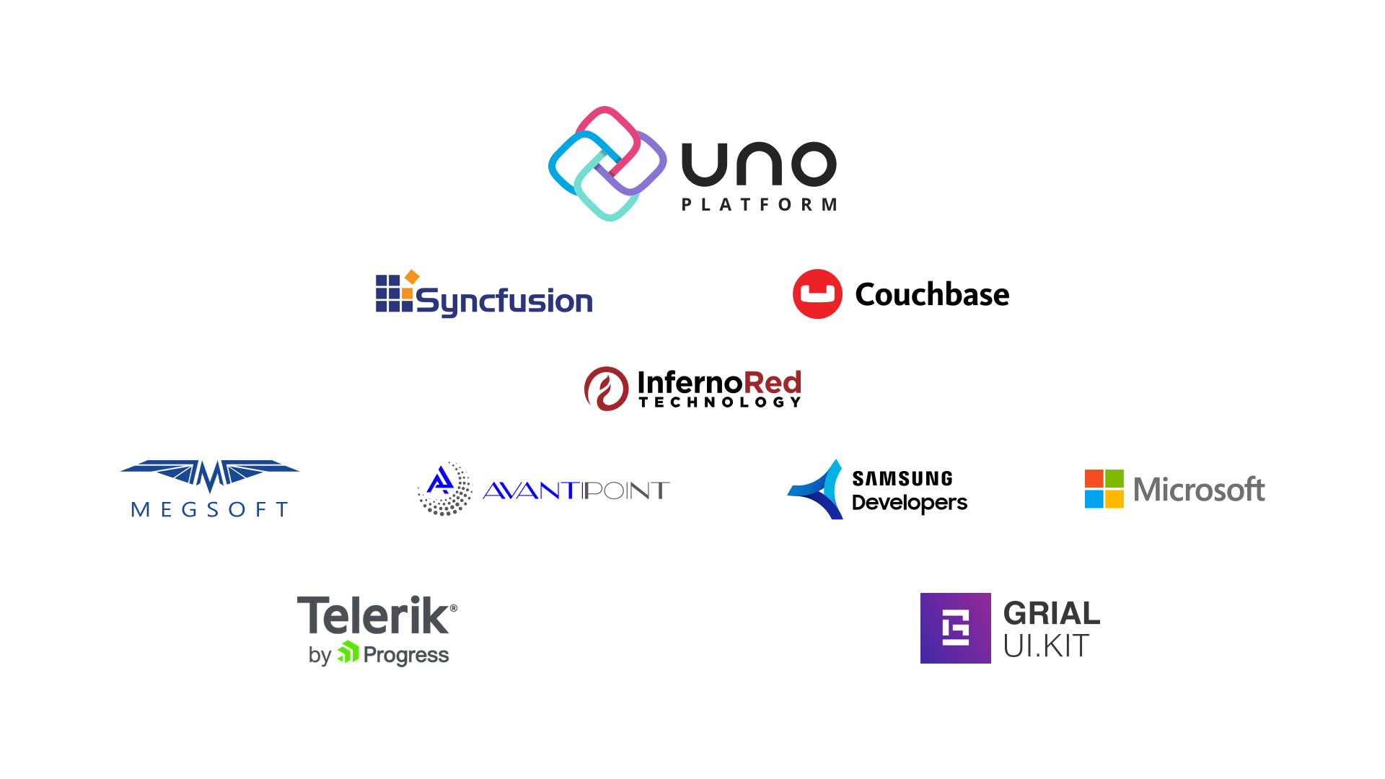

Slide 3
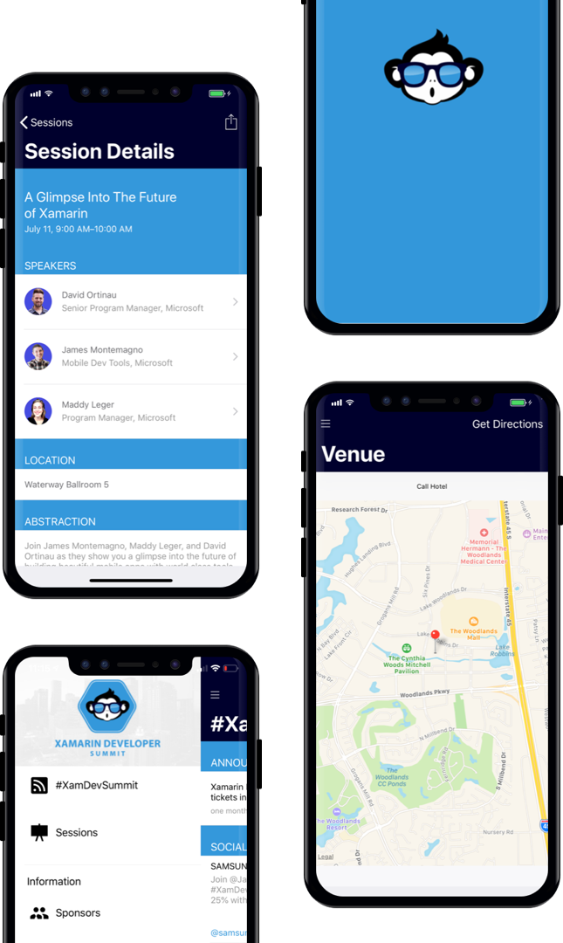
AGENDA
Download our Xamarin based mobile app: XamDevSummit.

Slide 4
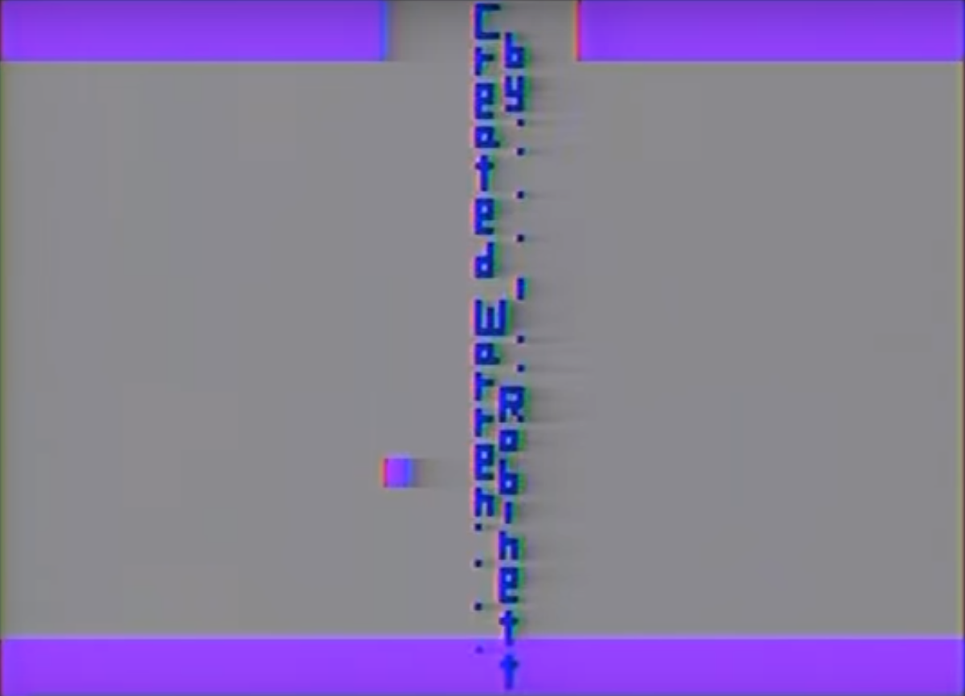



Rapid Enterprise Architecture
Paul Schroeder
@PaulBSchroeder

Slide 5
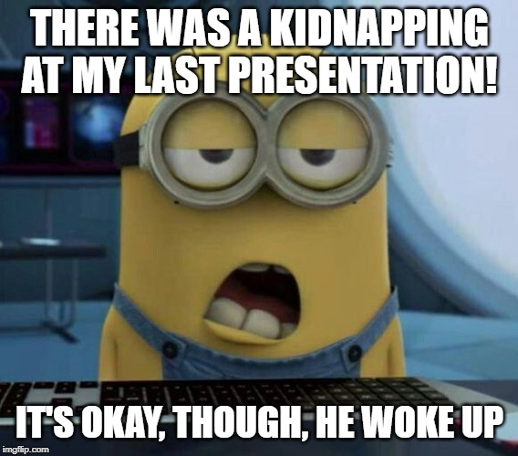

Slide 6

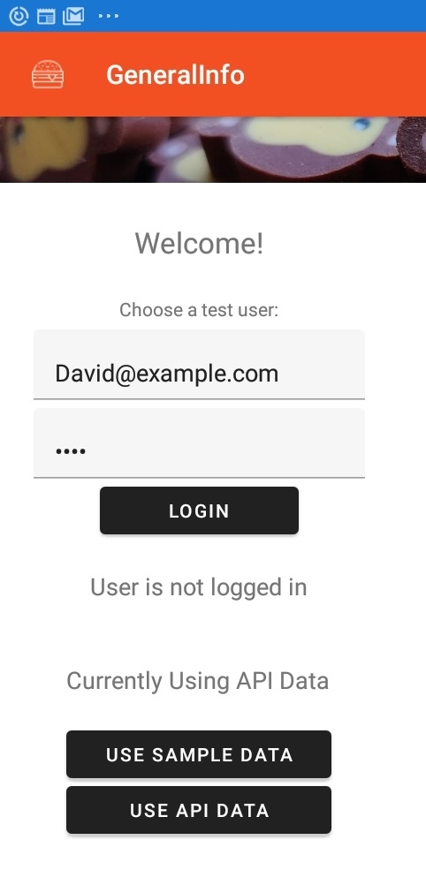
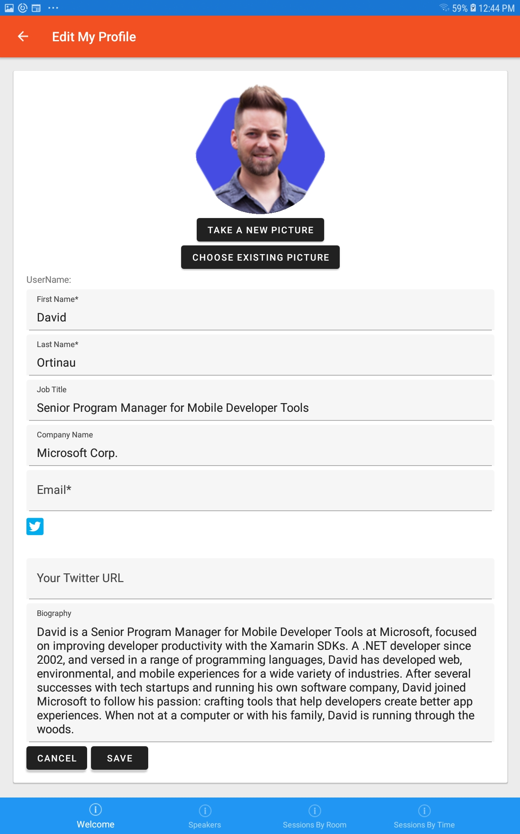
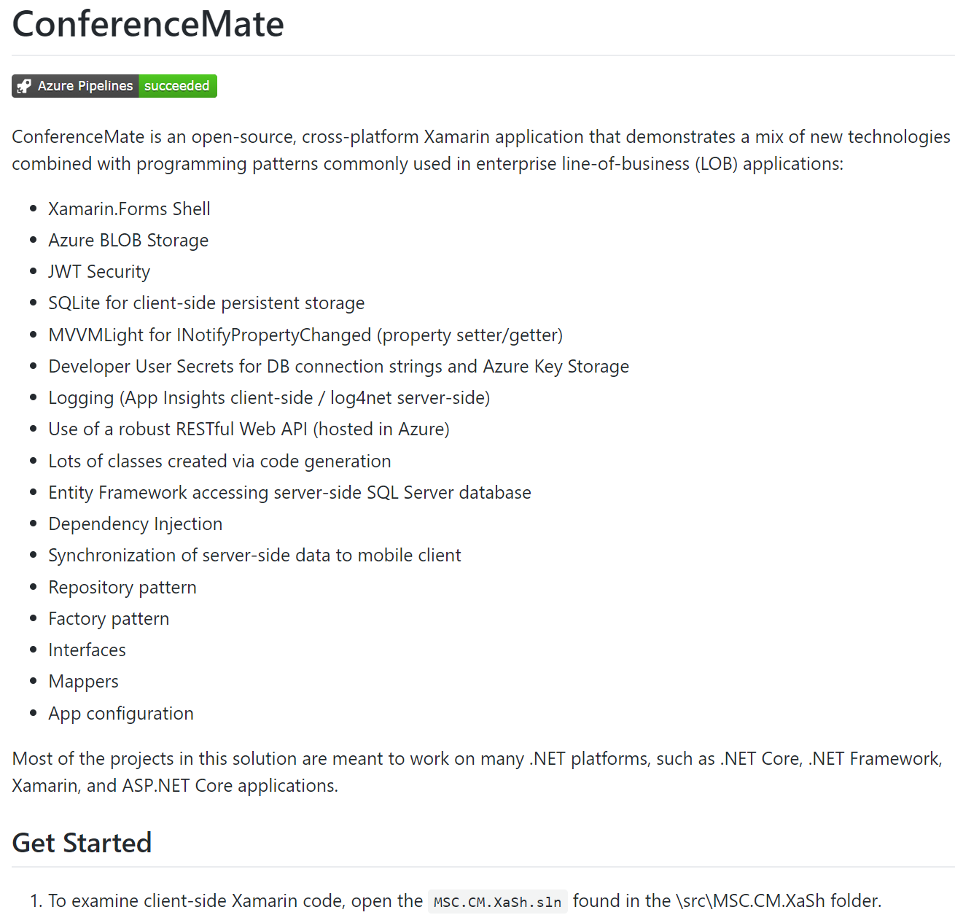
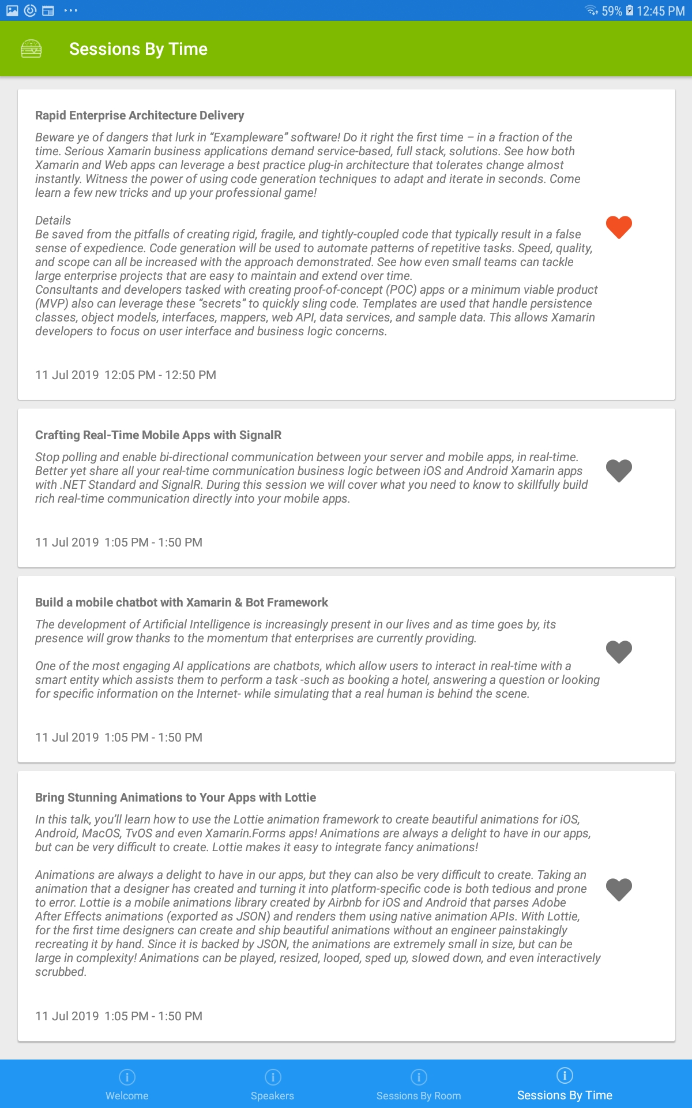
ConferenceMate Open Source App

Slide 7
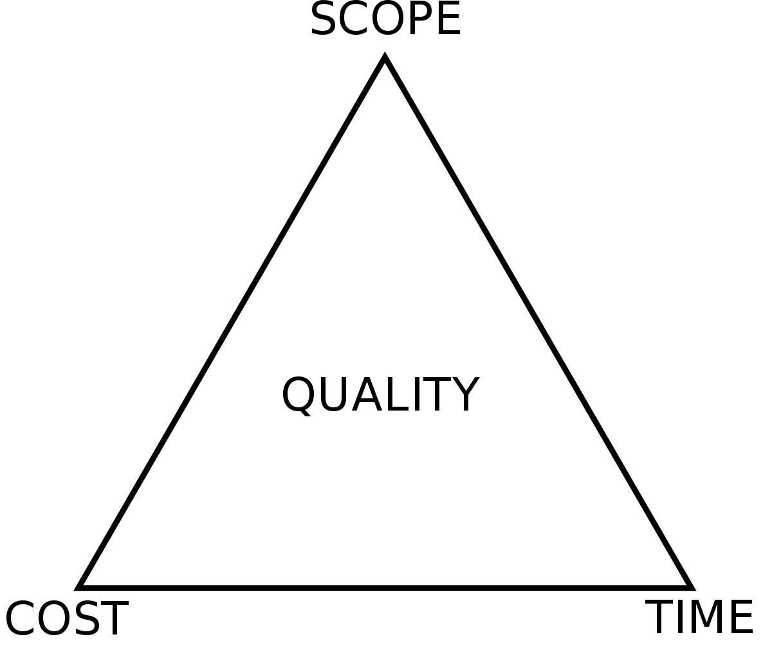
Project Management Triangle (aka Iron Triangle)
You can deliver at the right cost (budget) and on time (schedule), but may have to sacrifice scope.
You can have all the scope you want by the deadline you set, but the cost may be higher. (i.e. staff augmentation / OT)
Trade between constraints
Good, Fast, Cheap:
“Pick any two, you can’t have all three”
Should be fixed, but often suffers.

Slide 8

Problems
Not Aligned:
Budget, Scope, Time, Quality
Demo now, build it out later
Software Requirements:
Changes, Misses, Ambiguity
Development Team Turnover
App Differs from Market Needs
Systems Integration Challenges

Slide 9
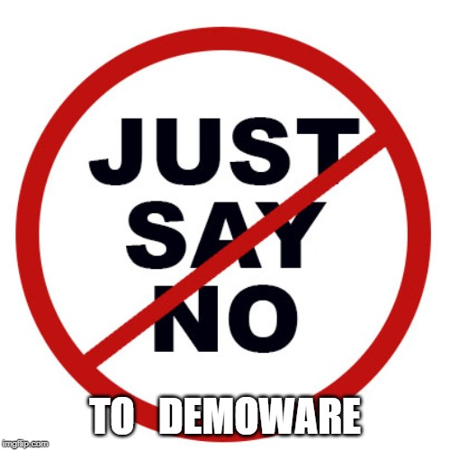
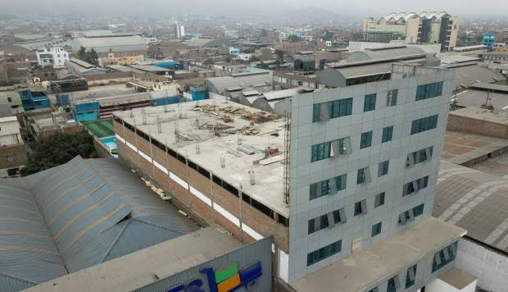
Beware of Demoware!
“There’s never enough time to do it right, but there’s always enough time to do it over.” – Jack Bergman

Slide 10

Root Cause of Problems
Insufficient Planning and Requirements
Focus on Demonstrations
Shifting Project Requirements
Losing Key Players
Feedback Loop is Lacking
Systems Integration Challenges

Slide 11

The Repeatable Solution
Time Reduced
Integration / Technology Risk Earlier
Adapt to Market Needs
Turnover Mitigated
Quality Increases
Code Generate Boilerplate Sections
Use Proven Software Patterns (SOLID)
Componentize Architecture (NuGet)
Craft a Reusable Architecture
4
3
2
1

Slide 12


High-level Architecture
After Code Generation –What’s Left?
SQL Server
Database
Web API
Data Load Service
SQLite
Database
Model
EF
DTO
DTO
Data
Mapper
Get All Pages
Mapper
lastUpdatedDate
Business Logic & Domain Classes
SERVER
Xamarin CLIENT
MVVM
View
MVVM
View Model
Model
Model
Obj
Data
Mapper

Slide 13
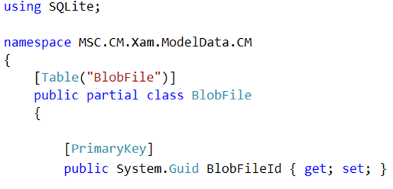
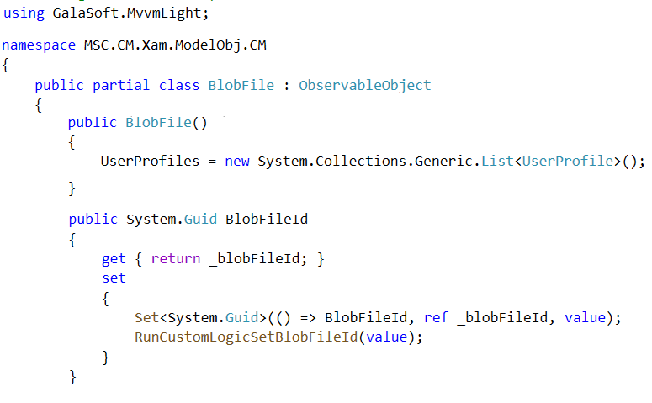
Single Responsibility Principle
SQLite classes - ModelData
MVVMLight classes - ModelObj

Slide 14

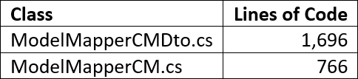
Models, Mappers, and DTO’s – Oh My!
22 classes for each:
SQLite
MVVMLight
DTO
Sample Data
88 classes you do not have to write !!!
// <auto-generated> - Template:SqliteModelData, Version:1.1, Id:c5caad15-b3be-…

Slide 15
Code Generation Basics
Create Templates
With expected input parameters (i.e. Table name, Column name)
Extract Inputs / Metadata from Source
i.e. DB Schema or Open API specification
“There is more than one way to skin a cat.”
“There are always several ways to do something.”
Run Templates with Metadata as Input
Output class files and incorporate them into your solution

Slide 16
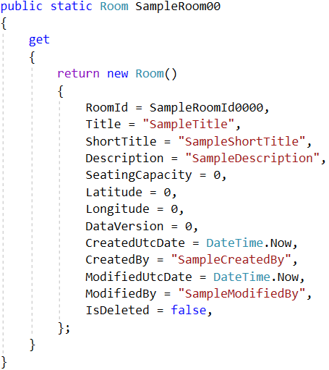
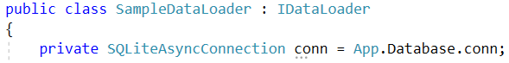
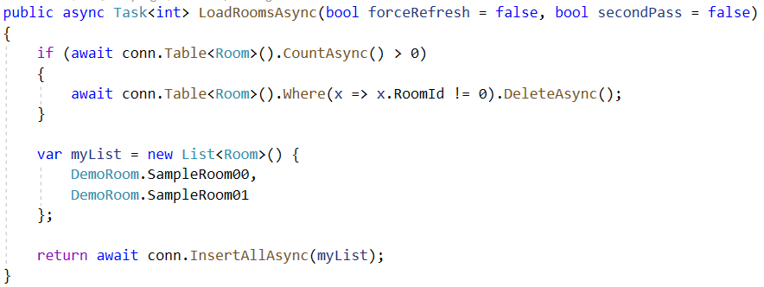
Sample Data
Data Loader
Robin Schroeder
3 pm tomorrow
// <auto-generated> - Template:XamSample, Version:1.1, Id:9131a0a2-…

Slide 17
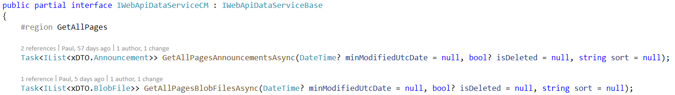
Client Code to Access Web API (Interface)
Abstract away the complexity of invoking the Web API
Provide CRUD operations
Get All Data
Get Pages of Data
Get By Primary Key
Create
Update
Delete
Useful for data synchronization
DateTime? minModifiedUtcDate
bool? isDeleted = null
Related entities
int numChildLevels
IPageDataRequest
string sort
int page = 1
int pageSize = 100
IList<IFilterCriterion> FilterCriteria

Slide 18
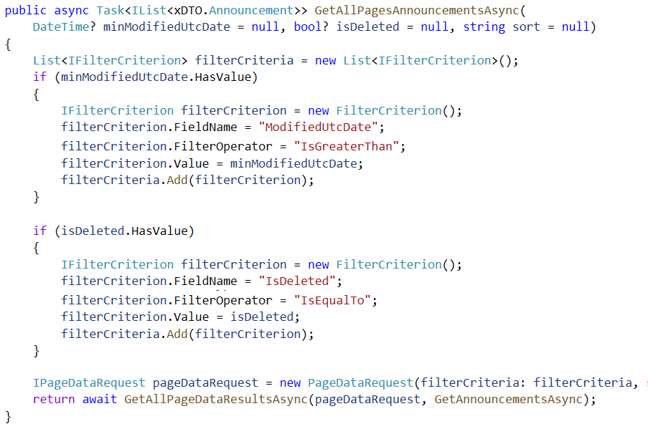
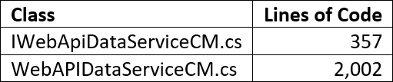
Client Code to Access Web API (Implementation)
What field(s) to use in filter?
How do you want to filter it?
Operator, Value, Sort
Your own custom methods
Partial Classes
// <auto-generated> - Template:WebApiDataService, Version:1.1, Id:424e7ec7-...

Slide 19
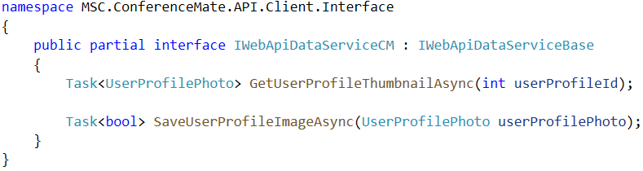
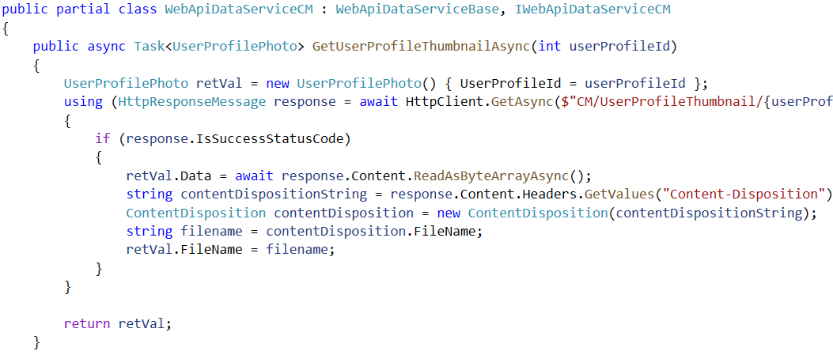
Save / GetUserProfileThumbnailAsync ( )
(Custom Partial Class)
“O” in SOLID
Open / Closed Principle
Custom code to
save / retrieve a user profile image
Flexibility - Implement a custom method using specific IFilterCriterion criteria

Slide 20
The Repeatable Solution
We are getting there!
Code Generate Boilerplate Sections
Use Proven Software Patterns (SOLID)
Componentize Architecture (NuGet)
Craft a Reusable Architecture
Touching on SOLID Along the Way
Generic Anemic Model for Data
Several Layers Code-Generated
4
3
Up Next
NuGet Components
Azure Blob Storage (Profile Photo)
Dependency Injection
Keeping Credentials Private
JWT Security / Postman Tests
Web API
Proof – CodeGenHero Magic
2
1

Slide 21
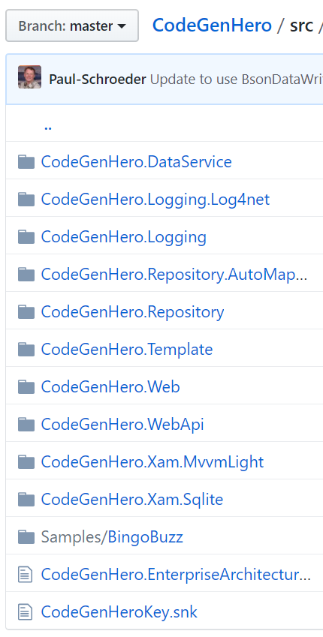
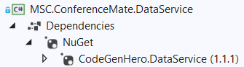
Open Source Components
Foundation classes referenced by the generated code
Base classes used to provide common functionality
GitHub Url
github.com/MSCTek/CodeGenHero/
NuGet Packages
www.nuget.org/packages?q=codegenhero

Slide 22
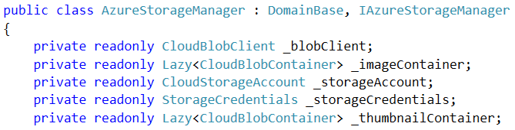
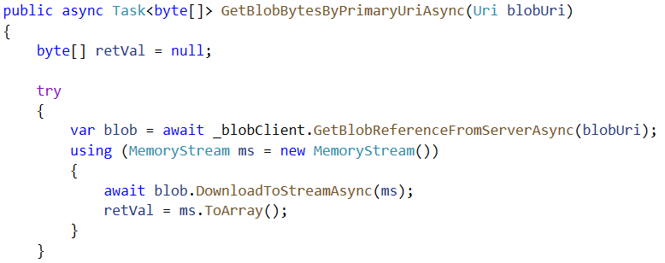
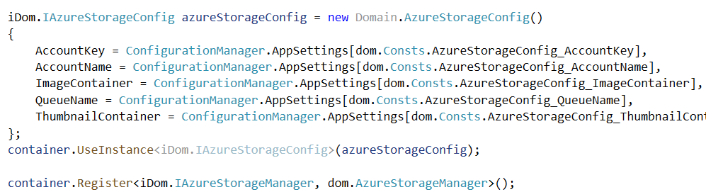
Azure BLOB Storage
Domain Classes – Go
Beyond Anemic Models
Class AzureStorageManager : DomainBase, IAzureStorageManager
IoCDependencyResolver.cs
DryIoc Dependency Injection

Slide 23
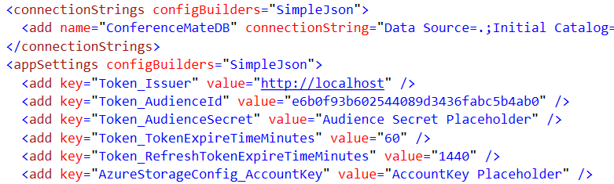
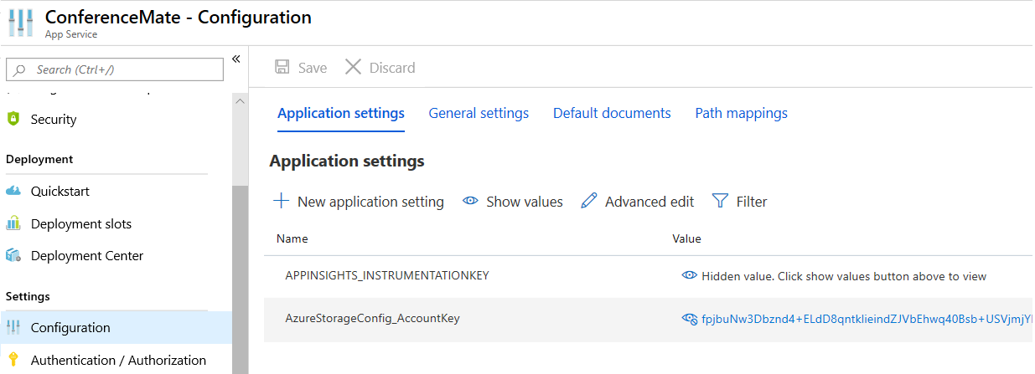
Configuration Secrets
Microsoft.Configuration.ConfigurationBuilders
Do not store sensitive app settings and connection strings in source control!
Azure Portal App Service Configuration
developer_config.json
{
"appSettings": {
"AzureStorageConfig_AccountKey": "fpjbuNw3Dbznd4…",
"Token_AudienceSecret": "kW9ys7u…
},
"connectionStrings": {
"ConferenceMateDB": "Server=tcp:msc…"
}
}

Slide 24
JWT Security
Based on Blog Post by AJ Kerezstes
github.com/akeresztesgh/TokenAuthInAspNet
ConferenceMate uses Microsoft.AspNet.Identity
ApplicationOAuthProvider.cs
JWTFormat.cs
RefreshTokenProvider.cs
Postman Tests
ISession injected ⇒ UserProfileImagesController
CurrentUser.Claims.First(x => x.Type == Consts.CLAIM_USERPROFILEID).Value
CurrentUser.IsInRole( Consts.ROLE_CONFERENCEORGANIZER)
if (_session.CurrentUserProfileId == userProfileId
|| _session.CurrentUserIsConferenceOrganizer)
Authorize attribute
Change User Profile Image
CodeGenHero
Volunteer – Give me a new table name

Slide 25



Thank You!
Q & A
Paul Schroeder
@PaulBSchroeder
Paul@MSCTek.com
Stickers &
Personal Demos are Available

